Slide 1

Business Awareness (BUAW) -
Revision Session

Slide 2

Topics
PESTLE Analysis
The Fundamental Ethical Principles and Threats (with money laundering)
Communication and Visualisation of Data

Slide 3
PESTLE Analysis
Match each of the descriptions to the relevant PESTLE factor.
Description | Factor
Demographic and cultural trends that influence customer behaviour and workforce patterns. These can have positive and negative effects depending on the type of business. Some examples relating to this factor are population size, age distribution, lifestyle trends and health. | Social
The potential to improve efficiently, reduce costs and increase the effectiveness of how a business operates through automation, artificial intelligence, e-commerce and digital communication. | Technological
External influences that arise from government actions and decision making. Usually in the form of policy changes, taxes and public spending. | Political
The laws and regulations that a business must comply with in the countries that they operate in. Failure to comply can result in fines, legal action or reputational damage. | Legal
Ecological issues that may affect how a business operates. Businesses are increasingly expected to operate responsibly when it comes to sustainability, waste management, carbon emissions and other similar regulations. | Environmental
The overall performance and condition of the economy in which a business operates. Typically includes interest rates, inflation, unemployment levels, exchange rates and customer spending. | Economic

Slide 4
Scenario 1
You work as an Accounts Assistant at Fresh Bites Ltd, a company that prepares and delivers multiple meal recipes to customers nationwide. You have received the following email from your manager. (10 marks)
From: B Jones, Finance Manager To: Accounts Assistant Subject: Concerns about external risks Hi all, I am writing to ask your advice on several external issues that may affect how we operate. Over the past 3 years, we have grown rapidly, particularly through our online subscriptions, but there are some concerns which could negatively impact our operations and profitability which I have mentioned below. The government has recently announced possible increases in corporation tax and changes to import tariffs on certain food products. As we import some ingredients from Europe and Asia, this could increase our costs. It’s also been mentioned that the government may be reducing support for smaller businesses following the recent economic recovery period. As well as this, inflation remains high and interest rates have risen again this quarter. Our energy, fuel and packaging costs have risen significantly, and some customers have cancelled subscriptions due to the rising cost of living. We are considering taking out a loan to invest in new refrigeration equipment, but borrowing is more expensive now. Also, we have noticed changing customer behaviour. Customers are becoming more price sensitive, and many are switching to supermarket own brand meal solutions instead. This is in addition to a growing public concern about food waste and ethical sourcing. Several competitors have invested in advanced app-based ordering systems using AI to personalise meal recommendations. Our current website is functional though a little outdated. We have experienced 2 minor cybersecurity incidents this year. There have also been some changes in employment law which include proposed increases to minimum wages and stricter regulations regarding delivery drivers. As we rely on part-time drivers, this could increase staffing costs. We must also ensure we comply fully with data protection regulations when handling customer information. Finally, environmental regulations are becoming stricter. The government is considering introducing a packaging tax on non-recyclable materials. We currently use insulated packaging that is not fully recyclable. Customer are also increasingly demanding environmentally sustainable delivery options, which may increase distribution costs. I would appreciate it if you could analyse the external threats and provide an explanation for 3 of the PESTLE factors and how each of these may affect the business. Thanks, Bob Jones

Slide 5
Scenario 1
You work as an Accounts Assistant at Fresh Bites Ltd, a company that prepares and delivers multiple meal recipes to customers nationwide. You have received the following email from your manager. (10 marks)
From: Accounts Assistant To: B Jones, Finance Manager Subject: Concerns about external risks Hi Bob, Thank you for your email outlining the external issues currently affecting Fresh Bites Ltd. I have analysed the below using the PESTLE analysis framework and identified several threats to the business. Political – The proposed increase in corporation tax and possible import tariffs on food products could significantly raise operating costs. As Fresh Bites imports ingredients, higher tariffs would increase supply costs, which may reduce profit margins unless selling prices are increased. However, increasing prices could result in further customer cancellations. Economic – High inflation and rising interest rates present a serious threat to the business. Increased fuel, energy and packaging costs will reduce profitability. In addition, customers facing cost of living pressures may cancel subscriptions, reducing revenue and therefore reducing profit. Higher interest rates also make borrowing more expensive, which could delay investment in new refrigeration equipment and limit future growth. Social – Changing customer behaviour is a risk. Customers becoming more price sensitive may switch to cheaper alternatives. Growing concerns about food waste and ethical sourcing could also damage the company’s reputation if it does not adapt to these expectations. This could lead to a reduction in revenue if customers choose to buy from competitors instead. Technological – Competitors investing in AI driven apps may gain a completive edge by offering customers a more personalised product. Our outdated website could lead to customer dissatisfaction and result in a loss of sales. Furthermore, cybersecurity incidents pose a threat to customer trust and could result in reputational damage or financial penalties. Legal – An increase in minimum wage and stricter employment regulations could raise staffing costs and reduce the businesses profit. Non-compliance with employment or data protection laws could result in fines and reputational damage. Environmental – There is a threat to the business due to stricter packaging regulations and potential taxes on non-recyclable materials. If we continue as we are, we could see an increase in costs and the business could see potential harm to its brand image amongst environmentally conscious customers. This could lead to a loss in sales and a further reduction to profits. Overall, these external factors could significantly increase costs, reduce customer demand and weaken our competitive position. It is important for the business to monitor these threats closely and consider strategic changes to reduce their impact. Kind regards, Accounts Assistant

Slide 6
The Fundamental Ethical Principles
There are five ethical principles that AAT have identified, and all members should follow these. Which of the descriptions provided below align with the correct ethical principle.
Description | Ethical Principle
Only carrying out work which you have the appropriate level of experience and qualifications to do and ensuring this is completed to the highest possible standard. | Professional Competence and Due Care
Sensitive or personal data is not disclosed to unauthorised individuals. It is not accessed by people or other organisations who do not have the right to see it. | Confidentiality
Acting openly and honestly in all business transactions and whilst at work. | Integrity
The accountancy profession has high expectations of the ways in which accountants should conduct themselves. Anything which brings the reputation of accountancy as a profession into disrepute is deemed to be unprofessional behaviour. | Professional Behaviour
Business decisions should not be influenced or biased by personal influences. Decisions should be impartial and based wherever possible on factual evidence rather than personal prejudice. | Objectivity

Slide 7
Threats
There are also five threats to the five ethical principles. Which of the descriptions provided below align with the correct threat.
Description | Threat
Occurs when the accountant knows that they (or someone close to them) will benefit by making a particular decision. | Self Interest
Occurs when the accountant is close to someone affected by their decisions. This could be caused by family or personal relationships, friendships or close business relationships. | Familiarity
The accountant may not be prepared to devote sufficient time and care to check their own work thoroughly. If they do find errors, they may be tempted not to disclose them. | Self Review
When the accountant promotes a position or opinion to the point that objectivity may be compromised. No preferential treatment should be given to specific stakeholders. | Advocacy
The accountant fears they will be harmed in some way by a course of action due to pressure from someone else. These threats could come from physical or emotional threats, blackmail, or the threat of losing their job. | Intimidation

Slide 8
Scenario 2
You work as an Accounts Assistant for a small construction company. One of the largest customers has recently started paying invoices in large amounts of cash. You notice that the payments are often just below £10,000 and are split into multiple smaller transactions.
You decide to query this with your manager but he tells you not to look too closely because the customer is very important to the business. He also asks you to record the payments as Consultancy Income instead of Construction Income to keep things simple. He strongly reminds you that the business cannot afford to lose this client.
You are required to:
Identify 2 ethical principles that are under threat (2 marks)
Identify the threats to those ethical principles (2 marks)
Explain 2 possible money laundering offences (2 marks)
Explain what the term ‘Placement’ means (2 marks)

Slide 9
Scenario 2
You work as an Accounts Assistant for a small construction company. One of the largest customers has recently started paying invoices in large amounts of cash. You notice that the payments are often just below £10,000 and are split into multiple smaller transactions.
You decide to query this with your manager but he tells you not to look too closely because the customer is very important to the business. He also asks you to record the payments as Consultancy Income instead of Construction Income to keep things simple. He strongly reminds you that the business cannot afford to lose this client.
You are required to:
Identify 2 ethical principles that are under threat (2 marks)
Identify the threats to those ethical principles (2 marks)
Integrity because your manager is pressuring you to record transactions incorrectly and not question the unusual cash payments, which could lead to you acting dishonestly. This creates an intimidation threat due to the manager putting on pressure to ignore the concerns, along with reinforcement of how important this client is to the business.
Objectivity due to you being influenced by the business's reliance on a major customer who pays in large cash amounts. This creates a self interest threat due to the prioritisation of retaining the client over complying with ethical and legal requirements.

Slide 10
Scenario 2
You work as an Accounts Assistant for a small construction company. One of the largest customers has recently started paying invoices in large amounts of cash. You notice that the payments are often just below £10,000 and are split into multiple smaller transactions.
You decide to query this with your manager but he tells you not to look too closely because the customer is very important to the business. He also asks you to record the payments as Consultancy Income instead of Construction Income to keep things simple. He strongly reminds you that the business cannot afford to lose this client.
You are required to:
Explain 2 possible money laundering offences (2 marks)
One of the possible offences is Concealing. This is done by the customer splitting cash payments into smaller amounts and recording them as Consultancy Income which could be an attempt to hide the true origin of the funds.
Another is Arranging. This is through the arrangement which facilitates money laundering by processing and recording transactions in a way that helps the customers funds to appear legitimate.
Explain what the term ‘Placement’ means (2 marks)
The term ‘placement’ in relation to money laundering is when funds from criminal activities are converted into what seem legitimate assets or are introduced into the financial system such as banks. This is where most criminals are at risk from being caught due to the high volumes of cash being deposited seemingly out of nowhere which raises questions from financial institutions and accountants.

Slide 11
Data Analysis
CBC Ltd is a company that sells office supplies. Over the first quarter of the year (January to March), the company experienced fluctuations in sales and expenses. The company made several key decisions: increasing advertising spend, changing supplier contracts, and launching a new product line. The company also tracks outstanding invoices, which have varied amounts of overdue periods.
The following data presents the budgeted and actual sales performance, expenses breakdown, and outstanding invoices for CBC Ltd.
You are required to answer the following:
1 – What is the purpose of the charts and graphs? (2 marks)
2 – What does the information from each piece of data tell us about the business performance? (4 marks)
3 – Is there anything to be concerned about and what recommendations do you suggest to help solve these issues? (4 marks)

Slide 12
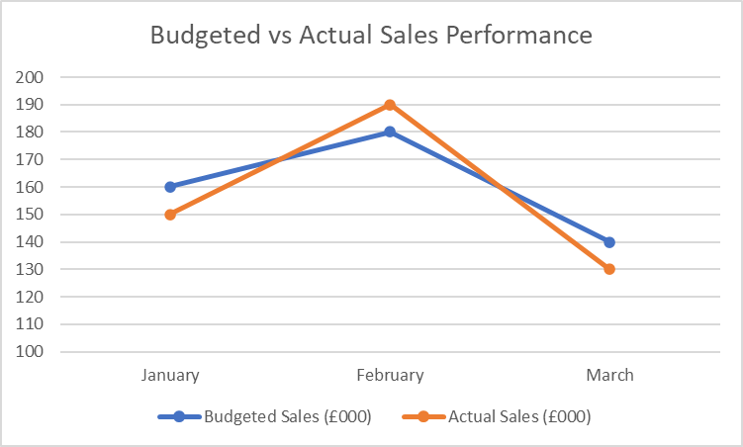
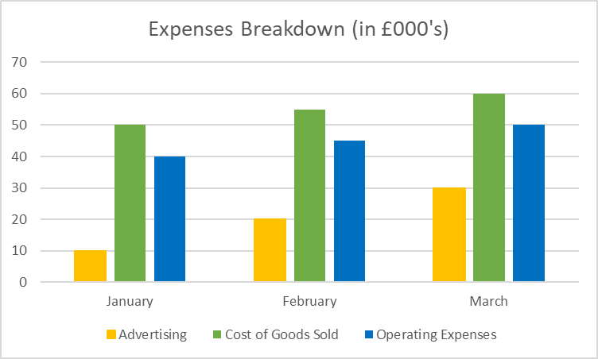
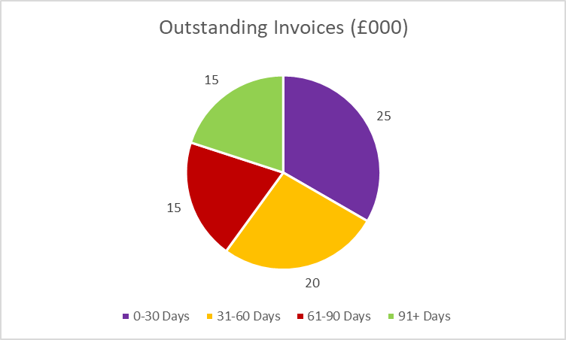
Data Analysis

Slide 13
Data Analysis
1 – What is the purpose of the charts and graphs? (2 marks)
The purpose of the charts and graphs is to enable the user to see the bigger picture relating to business performance. It is possible to identify patterns and trends in data by using a range of charts, graphs and diagrams. Analysis also allows for interrelationships in data to be identified.

Slide 14
Data Analysis
2 – What does the information from each piece of data tell us about the business performance? (4 marks)
In January, the actual sales were £150,000, £10,000 lower than the budgeted sales of £160,000. This suggests underperformance in January, which could be linked to the new product launch. If the new product didn’t generate the anticipated customer interest, it could explain the shortfall. Additionally, changing supplier contracts may have caused initial disruption, leading to potential stock shortages or delays in getting the product to market.
In February, the business exceeded the budgeted sales of £180,000 by £10,000, achieving £190,000 in actual sales. The increase in sales could be a direct result of the new product line gaining traction in the market, particularly if it took time to gain customer attention or if February saw improved marketing or distribution. The changing supplier contracts may have also had a positive impact in February by ensuring smoother product supply and better pricing, which could have helped support the increase in sales.
In March, the actual sales were £130,000, £10,000 below the budgeted sales of £140,000. The decline in March sales could suggest that the initial excitement around the new product had faded, or the changing supplier contracts may have caused temporary disruptions in product availability or pricing that affected customer buying decisions. Additionally, market saturation or an increase in competition could have also contributed to this decline.

Slide 15
Data Analysis
2 – What does the information from each piece of data tell us about the business performance? (4 marks)
January to March – Over the three-month period, total expenses increased from £100,000 in January to £140,000 in March. The increase in advertising expenses, from £10,000 to £30,000, could be tied to efforts to promote the new product line. These additional marketing efforts may have contributed to the strong performance in February. However, if these marketing efforts continued at a high cost without corresponding sales growth in March, it suggests that the return on investment (ROI) for advertising could be diminishing, particularly as the product's market excitement declines.
The changing supplier contracts could also impact operating costs, especially if suppliers offered less favorable pricing or had higher shipping costs, which may not have been fully factored into the expense projections.

Slide 16
Data Analysis
2 – What does the information from each piece of data tell us about the business performance? (4 marks)
The total outstanding invoices as of March 31st amount to £75,000. The breakdown shows that 40% of the outstanding invoices are over 60 days overdue, with 20% being more than 91 days overdue. This indicates a significant risk to cash flow and should be prioritised for collection.

Slide 17
Data Analysis
3 – Is there anything to be concerned about and what recommendations do you suggest to help solve these issues? (4 marks)
While the positive variance in February is encouraging, the company should aim for more consistent performance. The success of February should be analysed to replicate the factors that led to the positive variance, such as targeted marketing campaigns or product promotions. Additionally, if the new product line is to remain a major revenue driver, the company must continue to build awareness and engagement through ongoing marketing efforts.
The significant increase in advertising costs should be evaluated for effectiveness. If the return on investment (ROI) is low, the company should consider adjusting its advertising strategy to focus on more targeted or cost-effective campaigns. Also, the cost impact of the new product and changing supplier contracts should be considered when determining advertising and promotional budgets.
The 40% of invoices overdue for over 60 days could severely impact cash flow. Immediate follow-up and a more aggressive approach to collecting overdue payments are necessary.
The company should assess its rising costs, especially in advertising and operating expenses, to ensure they are aligned with revenue growth. Better cost management and renegotiating supplier contracts could help improve profitability. Given the impact of supplier contracts, exploring more cost-effective suppliers or renegotiating terms could provide significant cost savings.

Slide 18
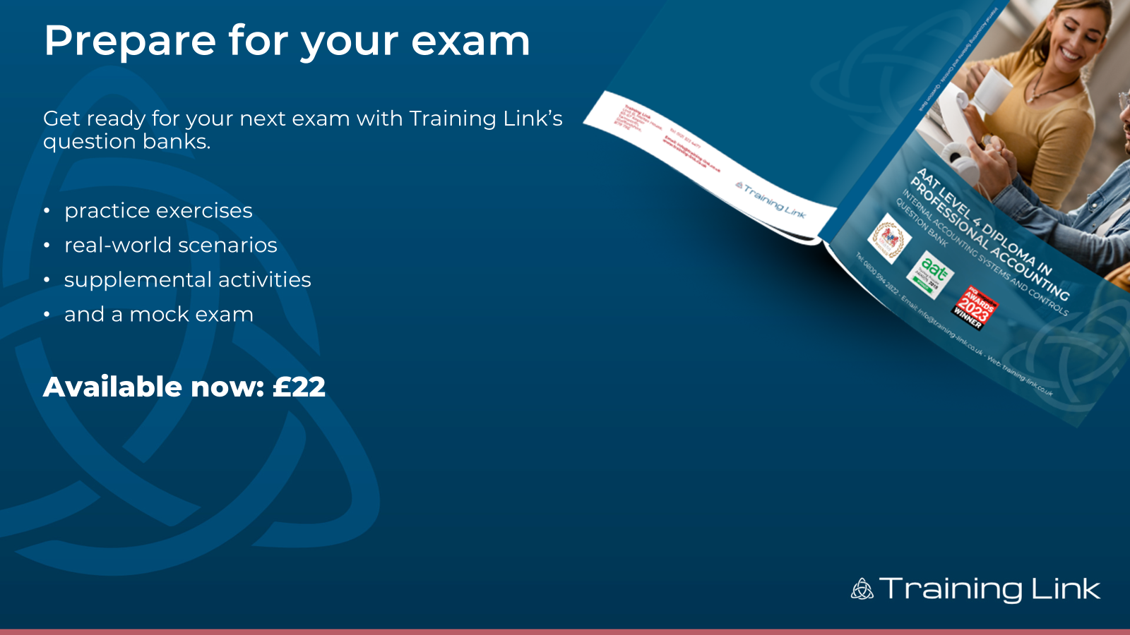

Prepare for your exam
Get ready for your next exam with Training Link’s question banks.
practice exercises
real-world scenarios
supplemental activities
and a mock exam
Available now: £22

Slide 19

Prepare for your exam
Get ready for your next exam with Training Link’s question banks.
practice exercises
real-world scenarios
supplemental activities
and a mock exam
Available now: £22

